Slide 1
A Brief History of Exploitation
Devin Cook
Auburn University
CIS 4930 / CIS 5930
Offensive Computer Security
Spring 2014

Slide 2
Overview
Security is a cat and mouse game. New mitigations are usually enacted as a reaction to an attack. Shortly after, new attacks are often developed that circumvent those mitigations.
Stack canaries, SEH
overwrite variables instead
SEH hacking
DEP/NX
ret2libc
ROP
ASLR
brute force, address disclosure, lazy developers
Any other examples?

Slide 3
The Old Days
Things used to be so easy for us… Here’s a stack frame:
bottom of top of memory memory buffer ebp ret a b c <------ [ ][ ][ ][ ][ ][ ] top of bottom of stack stack

Slide 4
The Old Days
We used to be able to just jump to shellcode via a ret instruction:
bottom of DDDDDDDDEEEEEEEEEEEE EEEE FFFF FFFF FFFF FFFF top of memory 89ABCDEF0123456789AB CDEF 0123 4567 89AB CDEF memory buffer ebp ret a b c <------ [SSSSSSSSSSSSSSSSSSSS][SSSS][0xD8][0x01][0x02][0x03] ^ | |____________________________| top of bottom of stack stack
Why is this possible?
How can we prevent it?

Slide 5
Stack Canaries
What if we do this?
bottom of top of memory memory buffer, locals canary ebp ret a b c <------ [ ][0xbeef][ ][ ][ ][ ][ ] top of bottom of stack stack
Now we can’t easily overwrite the return address.
could brute force, but not usually feasible
better strategy is to smash local variables
maybe function pointers if we’re lucky, otherwise maybe overwrite a pointer used for reading or writing memory so we can write to arbitrary locations
SEH is a bit more interesting

Slide 6
Stack Exception Handler
1st exception occurs :---- (1) | -------+-------------- (3) opcode in next SEH : jump over SE Handler to | | | the shellcode | V V [ Junk buffer ][ next SEH ][ SE Handler ][ Shellcode ] opcode to do (3) Shellcode gets executed jump over pop pop ret SE Handler | ^ | | | -------------- (2) will ‘pretend’ there’s a second exception, puts address of next SEH
location in EIP, so opcode gets executed
If you can cause an exception to be triggered, you can run your shellcode.
This is for Windows, but it’s kind of neat.

Slide 7
DEP/NX
Data execution prevention (DEP) prevents us from running anything stored on the stack, so that means shellcode is out.
Basically any writeable memory will not be marked as executable. If we can get control of EIP, though, can we still do anything with it?

Slide 8
DEP/NX
Data execution prevention (DEP) prevents us from running anything stored on the stack, so that means shellcode is out.
Basically any writeable memory will not be marked as executable. If we can get control of EIP, though, can we still do anything with it?
YEP

Slide 9
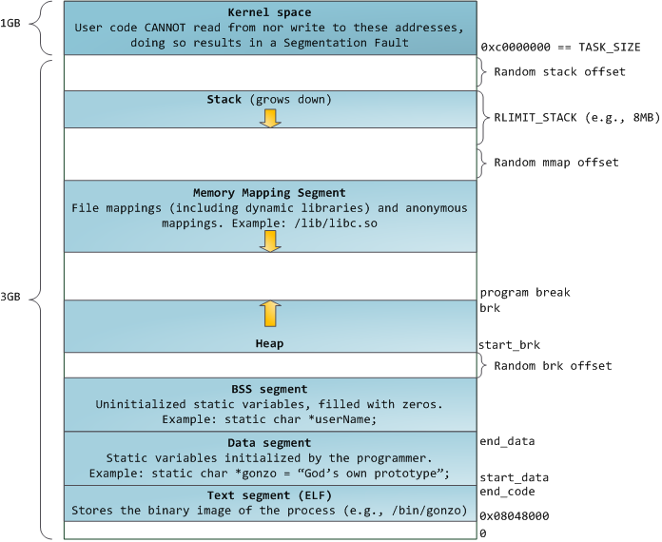
DEP/NX
Here’s what the memory
space of a process looks like.
See anything useful?

Slide 10
DEP/NX
Here’s what the memory
space of a process looks like.
See anything useful?
OH BOY

Slide 11
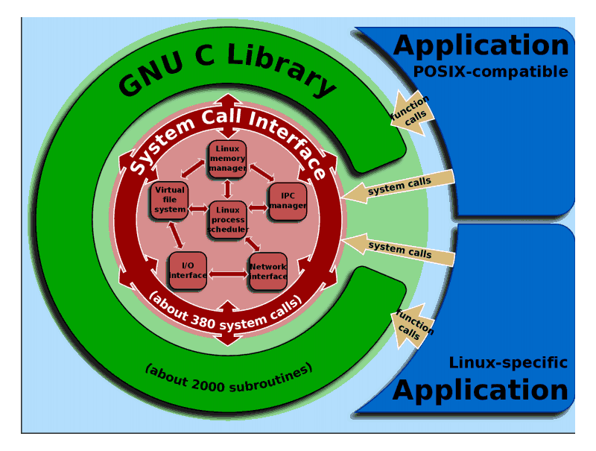
ret2libc
2,000 subroutines? We can work with that. We just need to make it return into one of those.

Slide 12
ret2libc
This is pretty easy as long as the function isn’t expecting any arguments or the arguments don’t matter. Here’s what it ends up looking like:
bottom of DDDDDDDDEEEEEEEEEEEE EEEE FFFF FFFF FFFF FFFF top of memory 89ABCDEF0123456789AB CDEF 0123 4567 89AB CDEF memory buffer ebp ret a b c [libs] ... [JJJJJJJJJJJJJJJJJJJJ][JJJJ][0x42][0x01][0x02][0x03] ^ | |______________________________________| top of bottom of stack stack
Unfortunately, to do anything useful we usually need to pass those functions some arguments.

Slide 13
Stack Pivoting
The current frame pointer (EBP) and stack pointer (ESP) are pointing at the frame we’ve just smashed. In order to make the called function see any arguments, we have to do something called a stack pivot. This allows us to create a stack with our own fake arguments and return addresses.
Basically we can create a new stack somewhere (maybe even on top of the old stack) and then fix the pointers.
How can we do that?
ESP
EBP
Old
New

Slide 14
Stack Pivoting
The current frame pointer (EBP) and stack pointer (ESP) are pointing at the frame we’ve just smashed. In order to make the called function see any arguments, we have to do something called a stack pivot. This allows us to create a stack with our own fake arguments and return addresses.
Basically we can create a new stack somewhere (maybe even on top of the old stack) and then fix the pointers.
How can we do that?
xchg registerContainingFakeStackAddress, ESP
add ESP, SomeConstant
sub ESP, SomeConstant
mov ESP, registerContainingFakeStackAddress
hack the function prologue because they modify ESP there
hack the function epilogue because they modify ESP there
ESP
EBP
Old
New

Slide 15
aside: ret2libc Mitigations
We can remove unnecessary functions from the libraries we link.
That still leaves all the functions available in our own code, and all the library functions that we don’t remove.
We can also make sure that the libraries get loaded into an area of memory with null bytes in the address.
Doesn’t help if we can write null bytes in our buffer overflow (i.e. not exploiting a string function).
Of course, making less functions available doesn’t prevent us from arbitrarily stringing together pieces of the available code in an order we specify...

Slide 16
ROP
Those techniques can be done with Return Oriented Programming (ROP). It utilizes small pieces of code, followed by a ret instruction. You can chain these “gadgets” together by simply writing their addresses in a row. This chain is often called a “ROP chain”.
Example gadgets:
push EAX pop ECX
ret ret
sub EAX, 4 add ECX, 8
ret ret
pop EBX pop EAX
xor EAX, EAX pop EBX
ret ret

Slide 17
ROP
Using ROP, we can accomplish several different things.
As Owen mentioned last week, if you have the right combination of gadgets, you can do ANYTHING (they can be Turing Complete).
Often the goal is to make some area of memory where your shellcode lives executable. You can also do things like change file descriptors.
You end up jumping around all over the memory space of the process, executing various bits of code that incrementally get you closer to the state you want it to be in.

Slide 18
ROP
Imagine the following gadgets:
xor %eax,%eax; ret 0x08041111
inc %eax; ret 0x08042222
pop %ebx; pop %ecx; ret 0x08043333
Before the buffer overflow the registers are:
%eax 0xbfffff53
%ebx 0x080482a3
%ecx 0x13
The objective is to set the following registers:
%eax 0x4
%ebx 0x41424344
%ecx 0x44434241

Slide 19
ROP
+------- Address of your buffer. (tab[0]) v 0xbfffe53c: 0x5f746973 0x90909020 0x90909090 0x90909090 0xbfffe54c: 0x90909090 0x90909090 0x90909090 0x90909090 +----------+ 0xbfffe55c: 0x90909090 0x90909090 0x90909090 0x90909090 | .text | 0xbfffe56c: 0x90909090 0x90909090 0x90909090 0x90909090 +----------+ +----------------------1------------>|0x08041111| xor %eax,%eax | +------------2------------<|0x08041113| ret | | +---------------1------>|0x08042222| inc %eax Saved ebp ----+ | | | +-----2------<|0x08042223| ret v ^ v ^ v 0xbfffe57c: 0x90909090 0x08041111 0x08042222 0x08042222 0xbfffe58c: 0x08042222 0x08042222 +--------------------------------------------1--->|0x08043333| | +-------------------------------2---<|0x08043333| pop %ebx | | +------------------3---<|0x08043334| pop %ecx | | | +------4---<|0x08043335| ret | P P | |..........| | O O | | P P | ^ v v v 0xbfffe594: 0x08043333 0x41424344 0x44434241

Slide 20
ROP
How can we make this more difficult?

Slide 21
ASLR
Address Space Layout Randomization changes the locations of everything in memory on a process-by-process basis.
32-bit: only 16 bits of entropy
64-bit: much more
important to note that ASLR is not always enabled for all libraries

Slide 22
Defeating ASLR
32-bit system: We can often brute force addresses.
If we don’t want to brute force, or we’re on a 64-bit system, we need some way of determining the address. This is called Address Disclosure.
Alternatively, there are some libraries that are still ASLR-disabled. That makes them pretty easy targets.
Fairly recently: http://cyvera.com/aslr-disabled-dropbox/

Slide 23
Future Mitigations
Control Flow Integrity
Works by restricting where you can return to by various means
shadow call stack
access control for memory regions
Still fairly academic, but looks promising
Sandboxing
Used in Chrome, Adobe Reader, etc.
Works pretty well, successful attacks must also escape the sandbox
Security is about increasing the cost (time and money) of an attack.
APT/targeted attacks can usually find a way in.

Slide 24
Tools
mona.py
Immunity plugin, now works on WinDBG
Can automatically generate ROP exploits for you
vivisect
Debugger from the kenshoto guys
Mostly in python, easily scriptable
ROPgadget
Great tool for creating your ROP catalogue
ropc
ROP compiler! Owen talked about this last week.

Slide 25
Post Exploitation
Once you have arbitrary code execution, what can you do with it?
Read/Write files - open(), fread(), fwrite()
Change user - setuid(), seteuid()
Execute other programs - exec*()
Phone home - socket(), connect(), nc
Establish persistence
Privilege Escalation
etc...

Slide 26
Practice
War games and CTFs can be a great learning experience. They’re also a great place to try out all of these techniques (sometimes on really weird architectures).
http://repo.shell-storm.org/CTF/
http://net-force.nl/challenges/
http://microcorruption.com/
http://io.smashthestack.org:84/

Slide 27

Questions?

Slide 28
References
https://www.soldierx.com/tutorials/Stack-Smashing-Modern-Linux-System
http://www.phrack.org/issues.html?issue=49&id=14
http://www.phrack.org/issues.html?issue=58&id=4
http://neilscomputerblog.blogspot.com/2012/06/stack-pivoting.html
http://neilscomputerblog.blogspot.com/2013/04/rop-return-oriented-programming.html
https://www.corelan.be/index.php/2009/07/25/writing-buffer-overflow-exploits-a-quick-and-basic-tutorial-part-3-seh/
http://duartes.org/gustavo/blog/post/anatomy-of-a-program-in-memory/
http://shell-storm.org/blog/Return-Oriented-Programming-and-ROPgadget-tool/

